Slide 1

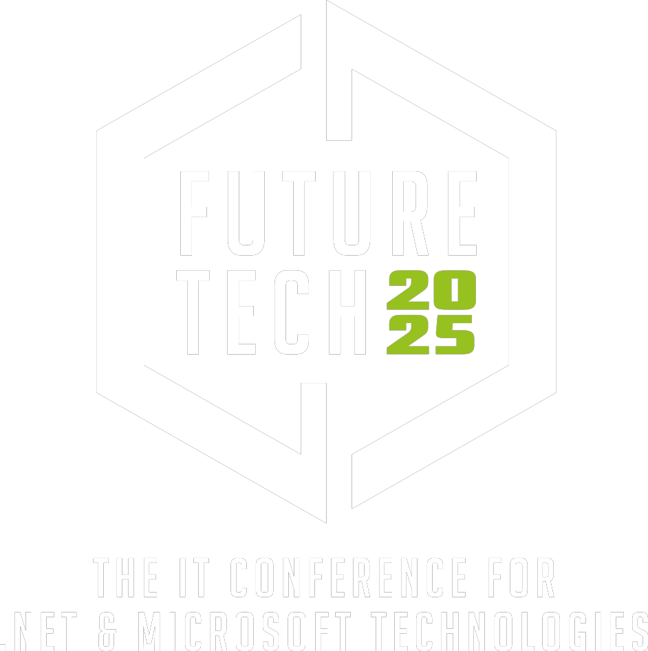

Platinum sponsor

Slide 2


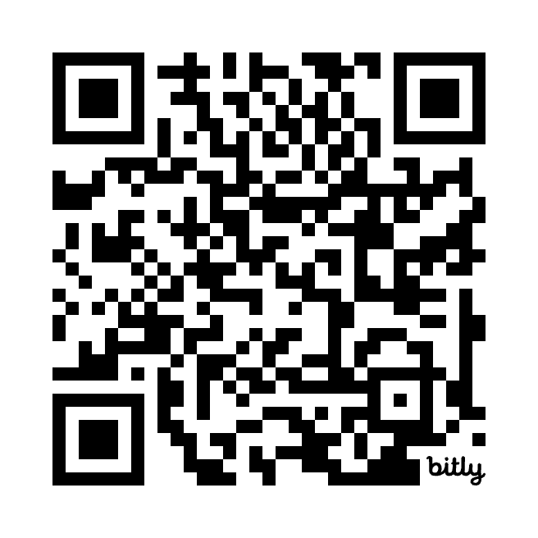
.NET Aspire: Let's build a cloud application with backed in observability

Slide 3
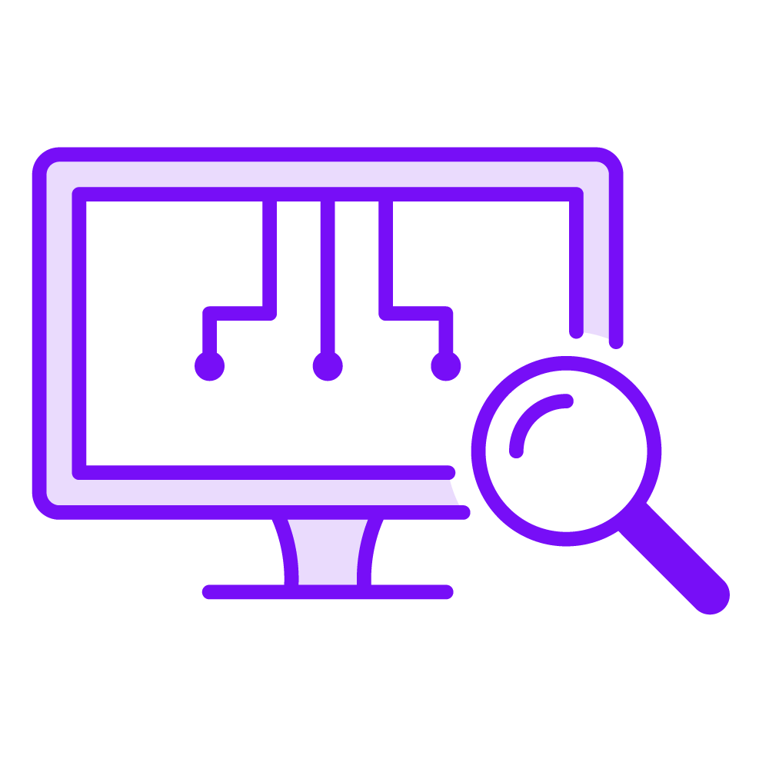
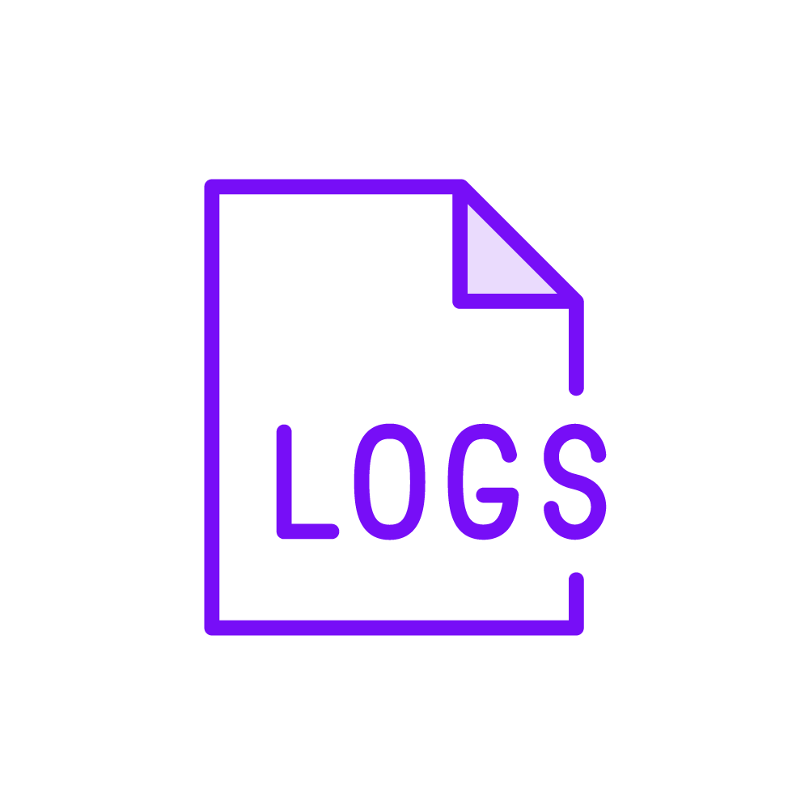

.NET Aspire: Let's build a cloud application with backed in observability
Observability parts and benefits
Monitoring
Capture and measure metrics
Gain insights into health and performance of the system
Logging
Record important events, actions and errors
Valuable for troubleshooting, auditing and detecting anomalies
Tracing
Capture and correlate execution path of a request
Reconstruct the end-to-end flow of a specific transaction

Slide 4
.NET Aspire: Let's build a cloud application with backed in observability
How does it work?
Follow an interaction by tagging it with an identifier. It stays with the transaction as it interacts with microservices, containers, and infrastructure. Offering visibility from the top of the stack to the application layer and the infrastructure beneath.
Solved by using OpenTelemetry

Slide 5

.NET Aspire: Let's build a cloud application with backed in observability
Span ( user action ) – root span
Span ( front end )
End-to-end request overview
Span ( API A )
Front end
API A
Span ( user API B )
API B
Database
Trace
Span ( Database )

Slide 6
.NET Aspire: Let's build a cloud application with backed in observability
What is OpenTelemetry?
OpenTelemetry is a set of APIs, SDKs, tooling and integrations that are designed for the creation and transporting telemetry data such as traces, metrics, and logs.
OpenTelemetry.io

Slide 7
.NET Aspire: Let's build a cloud application with backed in observability
What is it ‘OpenTelemetry’ not
It is not a data store
It is not a visualisation tool
It is not a data analytics or management environment

Slide 8
.NET Aspire: Let's build a cloud application with backed in observability
OpenTelemetry Protocol is a vendor and tool agnostic protocol specification: OTLP
Transmit telemetry data from the SDK
to a third party environment directly
Grafana, elastic, seq, datadog, splunk, …
through an OpenTelemetry Collector
.NET Aspire can act as such a third party environment
OpenTelemetry Infrastructure

Slide 9
.NET Aspire: Let's build a cloud application with backed in observability
What is .NET Aspire?
It provides an API to describe resources with their dependencies, and a runtime to resolve these dependencies.
This orchestration is intended to ease local development of distributed applications.

Slide 10
.NET Aspire: Let's build a cloud application with backed in observability
App model
Collection of resources that make up your distributed app
Uses the builder pattern
App host
The project that orchestrates the app model
Resource
A dependent part of the app, a .NET project, container, executable, database, cache, or cloud service
Integration
NuGet package with tooling or service, like Redis, PostgreSQL, SQL Server
Reference
Defines the connection between resources
.NET Aspire terminology

Slide 11

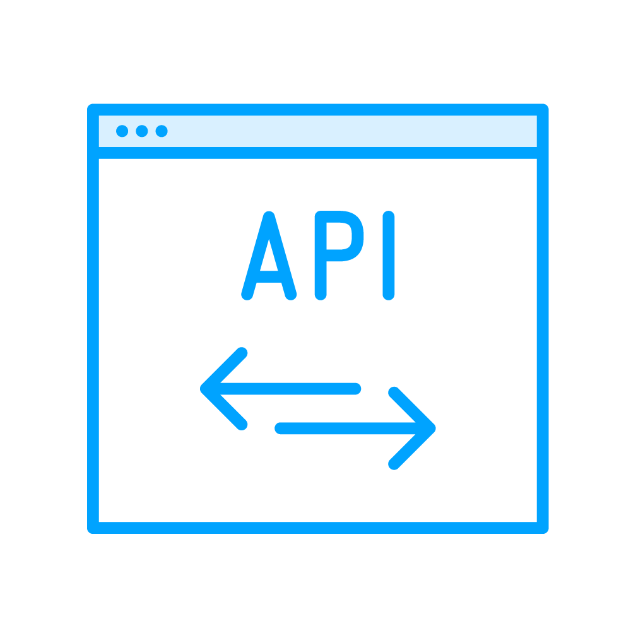
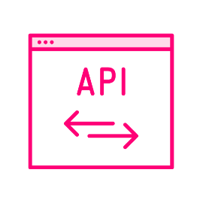
.NET Aspire: Let's build a cloud application with backed in observability
Microservice
Microservice
Website
API
API
OTLP
Data store Azure Monitor, Grafana stack,
ELK stack, …
OpenTelemetry Direct

Slide 12
.NET Aspire: Let's build a cloud application with backed in observability
https://github.com/Depechie/2025-futuretech-observability
https://github.com/Depechie/OpenTelemetryGrafana/tree/aspire
https://github.com/Depechie/Pluralsight-Otel-Course
https://dotnet.social/@depechie

Slide 13
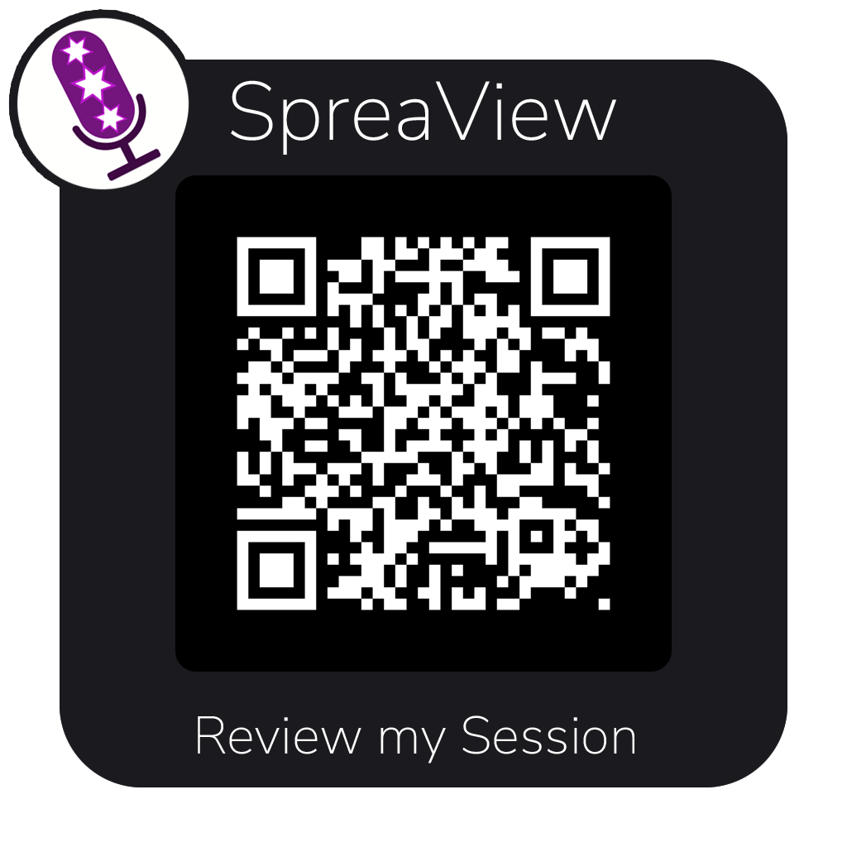
.NET Aspire: Let's build a cloud application with backed in observability

Slide 14
Thanks for your attention!

